Slide 1
Poster Number 133
Visualization of Abstract Theories in DSP Course Based on CDIO Concept
Wang Li-juan, Li Jian
and Zhen Xiao-qiong

Slide 2
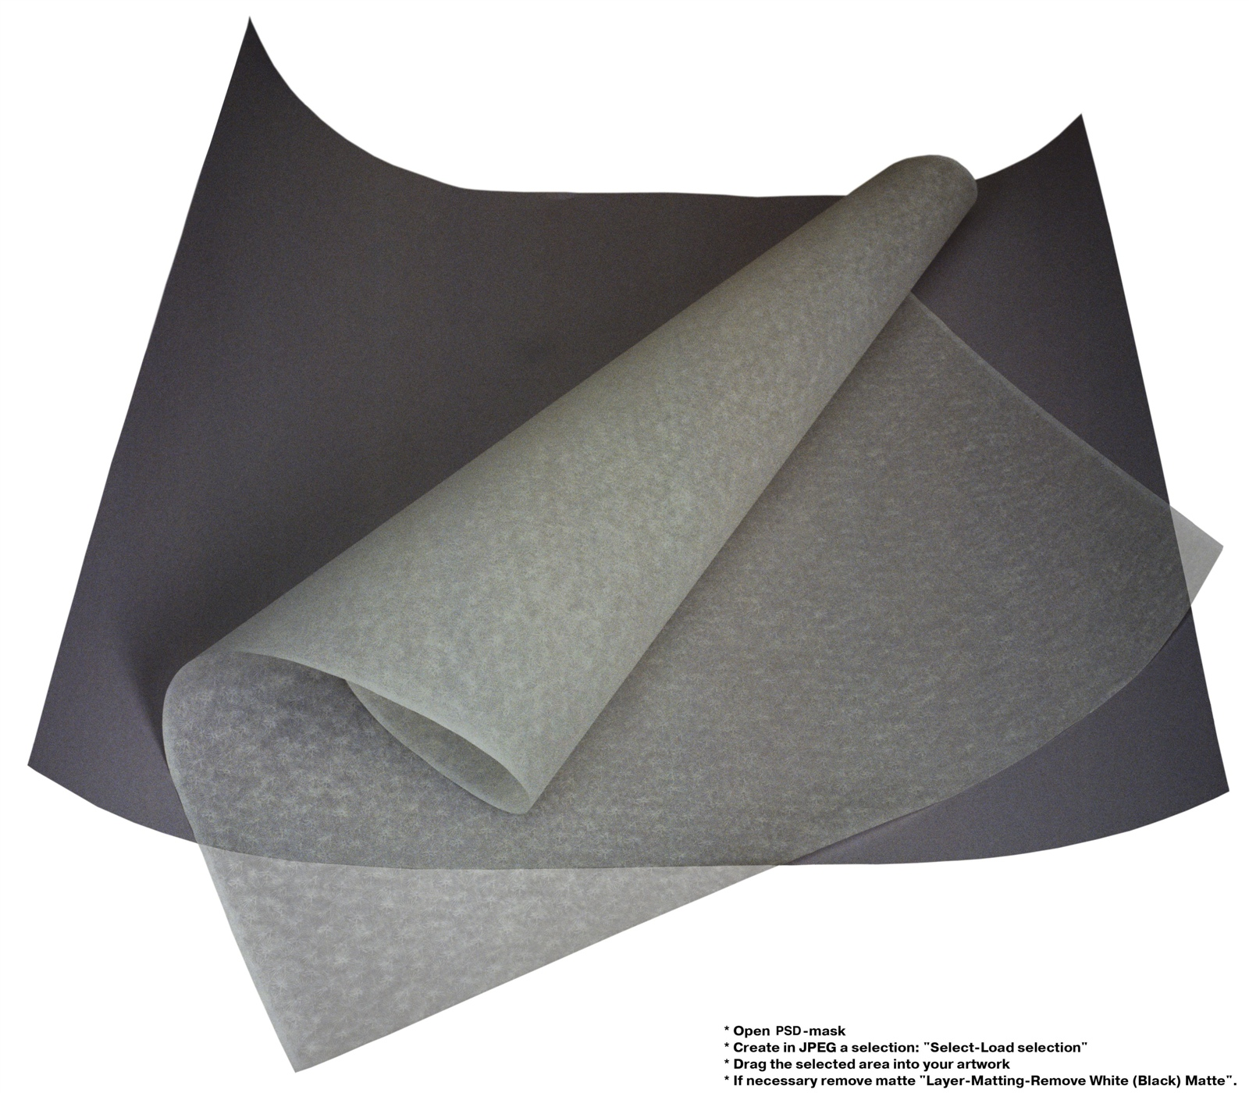
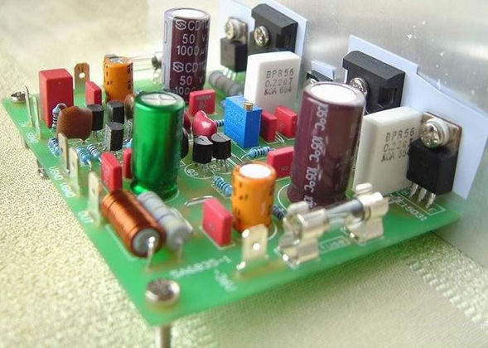
#133
PHOTO
Abastraction
(1).Write down the formula
1
(2).Analyze the physical meaning of the formula
2
Idea of the paper
(3).Conceive a nature thing or phenomenon similar to the physical meaning
3
(4).Find the similarity between the nature thing/phenomenon and formula
4
Visualization

